Slide 1
Project Increment – 1 CSEE 5590-0002 : Web/Mobile Programming
KC Donation
Team 3 :
Roshna Toke, ClassID: 23
Manaswini Vedula, ClassID: 24
Yamini Saraswathi Bommineni, ClassID: 03

Slide 2
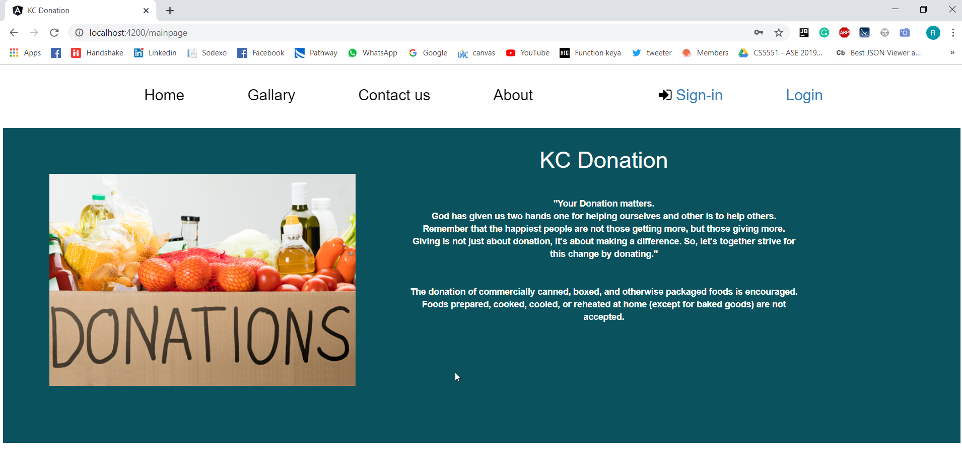

Slide 3
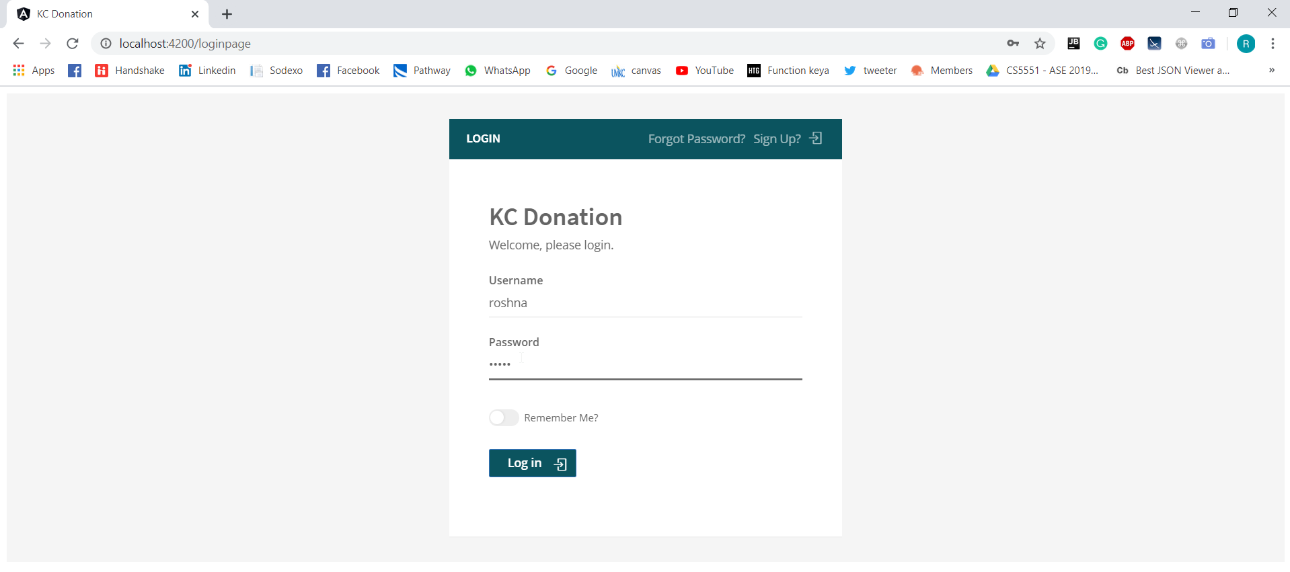

Slide 4
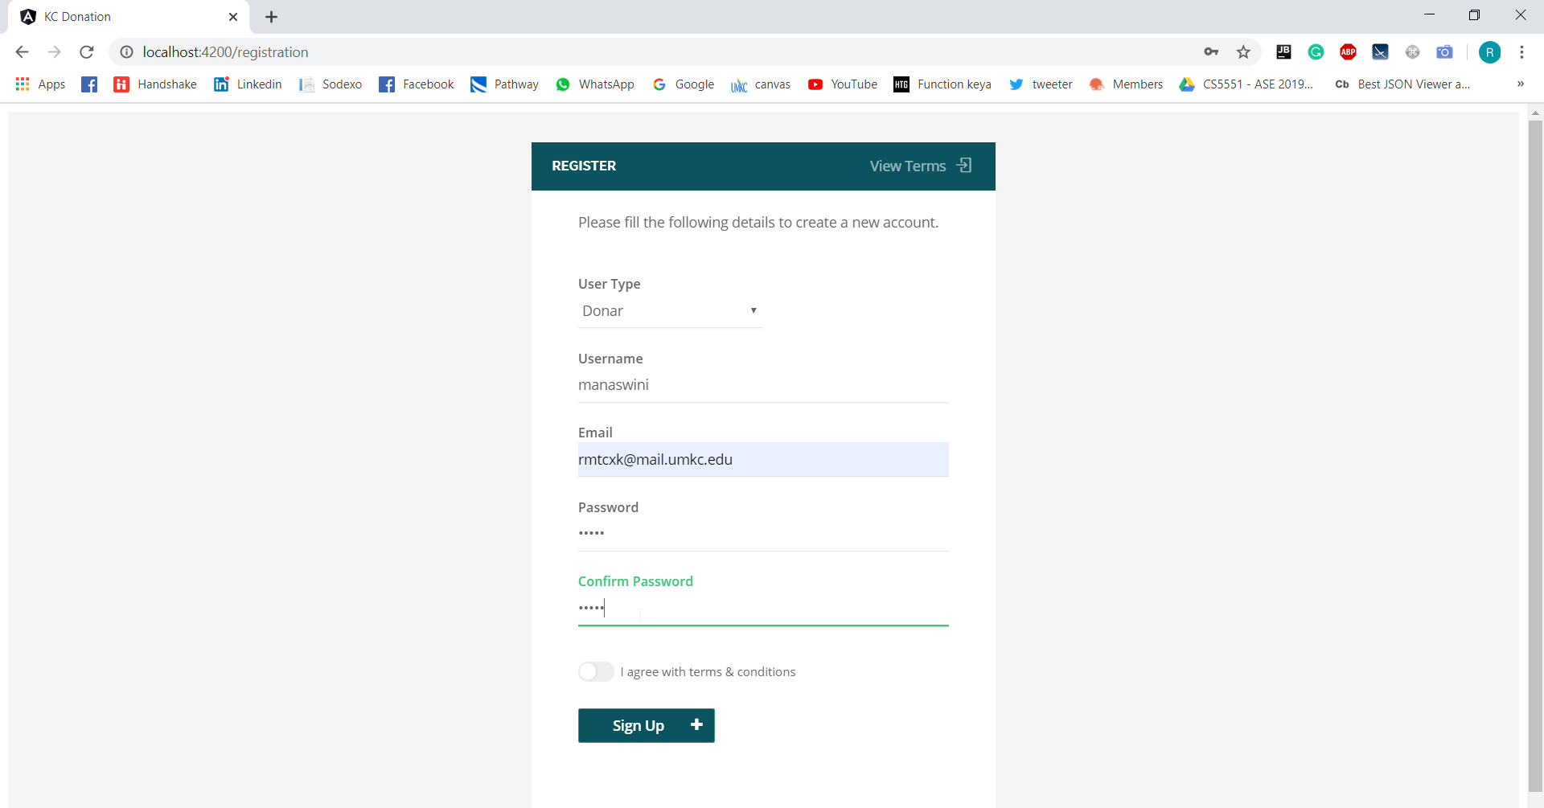

Slide 5
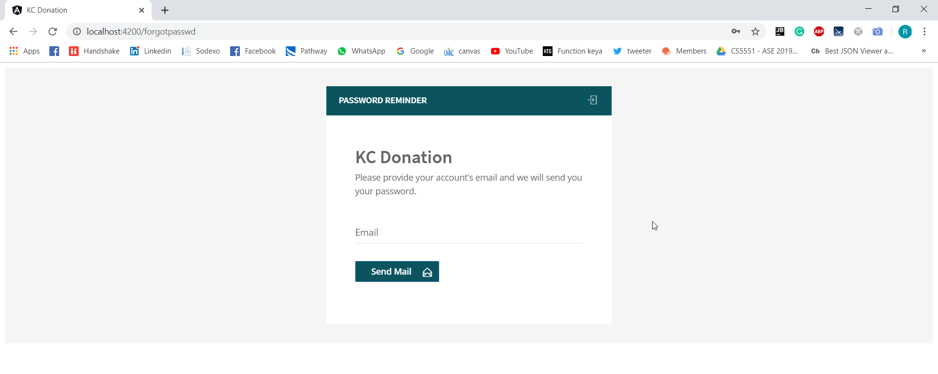

Slide 6
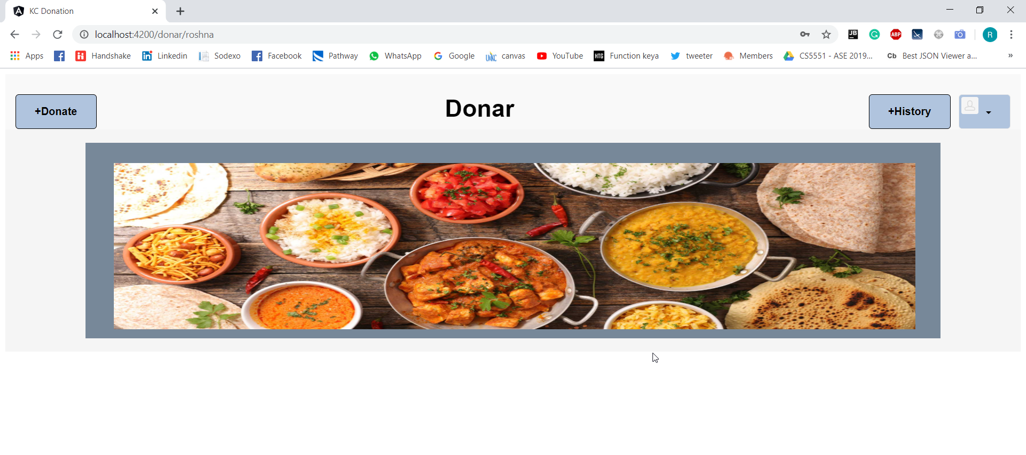

Slide 7
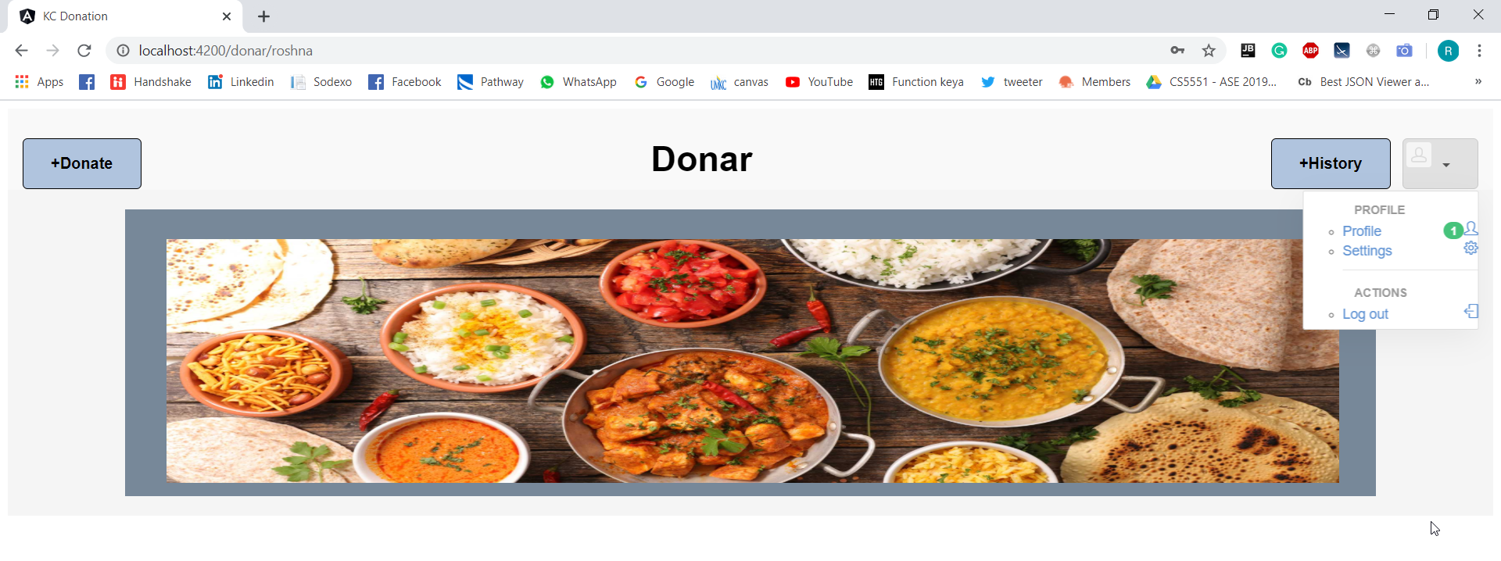

Slide 8
